Slide 1
Determining the Concentration of Sperm with a Hemocytometer
1. The hemocytometer is a device for counting cells or particles. As you can see below it is composed of a thick piece of glass with 2 rails on each side. The rails are designed to hold a cover slip 0.1 mm above a mirrored surface in the center. This surface has a grid etched into it. Be sure to clean the hemocytometer and the cover slip before beginning using a little water or alcohol followed by drying with a kewpie

Slide 2
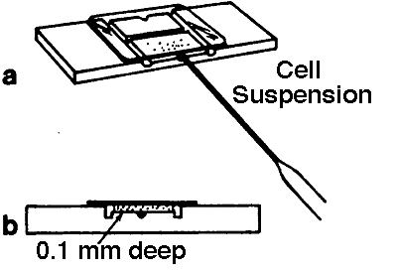
figure 1

Slide 3
2. Prepare an incubation chamber (large petridish with supports for hemocytometer and wet paper in the bottom).
3. Dilute sperm with water. The objective is to kill sperm and to dilute them sufficiently so that you will count 100 - 400 sperm cells in the 5 squares as described below. The exact dilution needs to vary with the species and concentration of the ejaculate. A general guide line follows:

Slide 4
Species | Dilution | Volume Semen | Volume Water
Bovine | 101 | 10 µl | 1.0 ml
Equine | 21 | 50 µl | 1.0 ml
Porcine | 21 | 50 µl | 1.0 ml
Ovine | 201 | 25 µl | 5.0 ml

Slide 5
4. Place a cover slip on the hemocytometer after wetting supports (rails) with saliva or water. This helps to hold down the cover slip while loading the sperm.
5. Place 10-15 µl of the diluted sperm under the cover slip on each side of the hemocytometer as shown in the figure 1a above.
6. Carefully place the hemocytometer in the pre wetted chamber, close the lid and wait 5 minutes.
7. Remove the hemocytometer without tilting it, dry the bottom if needed and place on a microscope. View the hemocytometer with a 40 X objective.

Slide 6
8. If you have used a phase type hemocytometer (the thin ones) then be sure the phase rings are in and the condenser is all the way up. You should be able to focus on the sperm but be careful not to break the cover slip. If you used one of the thicker hemocytometers, pull the phase rings out and close down the aperture on the condenser so that you can see the sperm. You may also need to raise or lower the condenser so you can see the sperm.
9. Count the sperm in 5 of the squares as shown in the following images. Be sure you count 5 squares on each side of the hemocytometer and then use the average for your calculations.

Slide 7
A-Low Magnification View of the hemacytometer grid system. Note that each side of the hemacytometer has an identical grid system consisting of 25 large squares in which each large square is divided into 16 smaller squares.

Slide 8
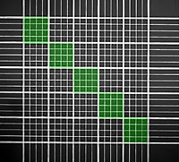
B-Count sperm heads in the 5 large squares as indicated by the green color. Each of these large squares contains 16 smaller squares.

Slide 9
A-Below is one of the green squares enlarged for a closer view. Count all sperm heads that have more than half the sperm head within the area indicated by the green color. For this particular hemacytometer, each of the large squares is bounded by a triple set of lines. The center line of these is the edge of the counting area. For sperm that lie with exactly half the sperm head on the edge of the green area, count only those heads on the sides indicated by the red line (top and right side).

Slide 10
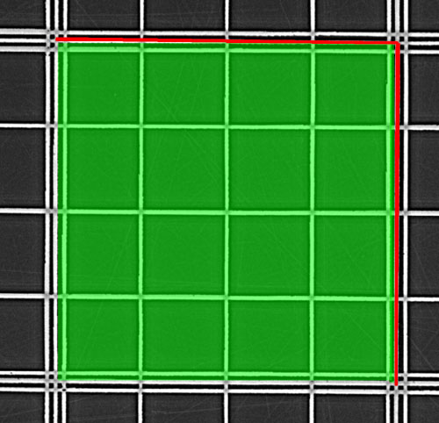

Slide 11
B- In this square, there are 29 sperm counted. The pattern of counting begins at the top left and then proceeds through the 16 small squares. The sperm indicated with an * were not counted because these sperm were either more than half way outside of the counting area or were not on the top or right side of the large square. Note that sperm 6 was counted because although half way on the top edge of the counting area of the large square, this is one of the two sides (top and right) that will be counted in this type of a situation. Sperm 5 and 9 were counted because they were more than half way below the top center line.

Slide 12
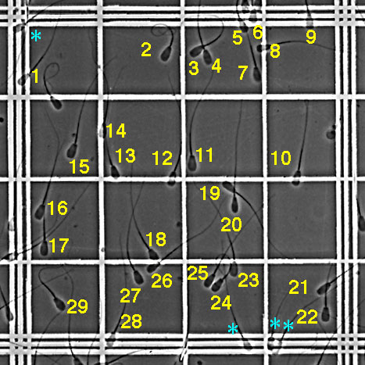

Slide 13
10. The hemocytometer is 0.1 mm deep and the 25 large squares represent an area of 1 square mm. The volume above the 25 squares shown is 0.1 µl. As you are only counting 5 squares, you counted the sperm that settled out of 0.02 µl (0.1/5=0.02). Therefore you must multiply your count in 5 squares by 50,000 in order to determine how many sperm would have been in 1.0 ml (1000/0.02=50,000; we usually express sperm concentration in terms of numbers/ml).

Slide 14
To get the concentration of the original sperm sample we must however also multiply by the dilution factor. The equation that follows would be used to convert the counts in 5 squares to concentration/ml:
Concentration/ml = (Dilution Factor)(Count in 5 squares)(0.05 X 10⁶).
By convention, sperm concentration is usually expressed in terms of sperm X 10⁶/ml.

